Slide 1


MOTION SICKNESS
and what the F. do we do about it?

Slide 2

“Motion sickness is a sensation of wooziness. It usually occurs when you’re traveling by car, boat, plane, or train. Some people learn early in their lives that they’re prone to the condition.”
- www.healthline.com
Notes:
What is motion sickness?
“Motion sickness is a sensation of wooziness. It usually occurs when you’re traveling by car, boat, plane, or train. Some people learn early in their lives that they’re prone to the condition.”

Slide 3
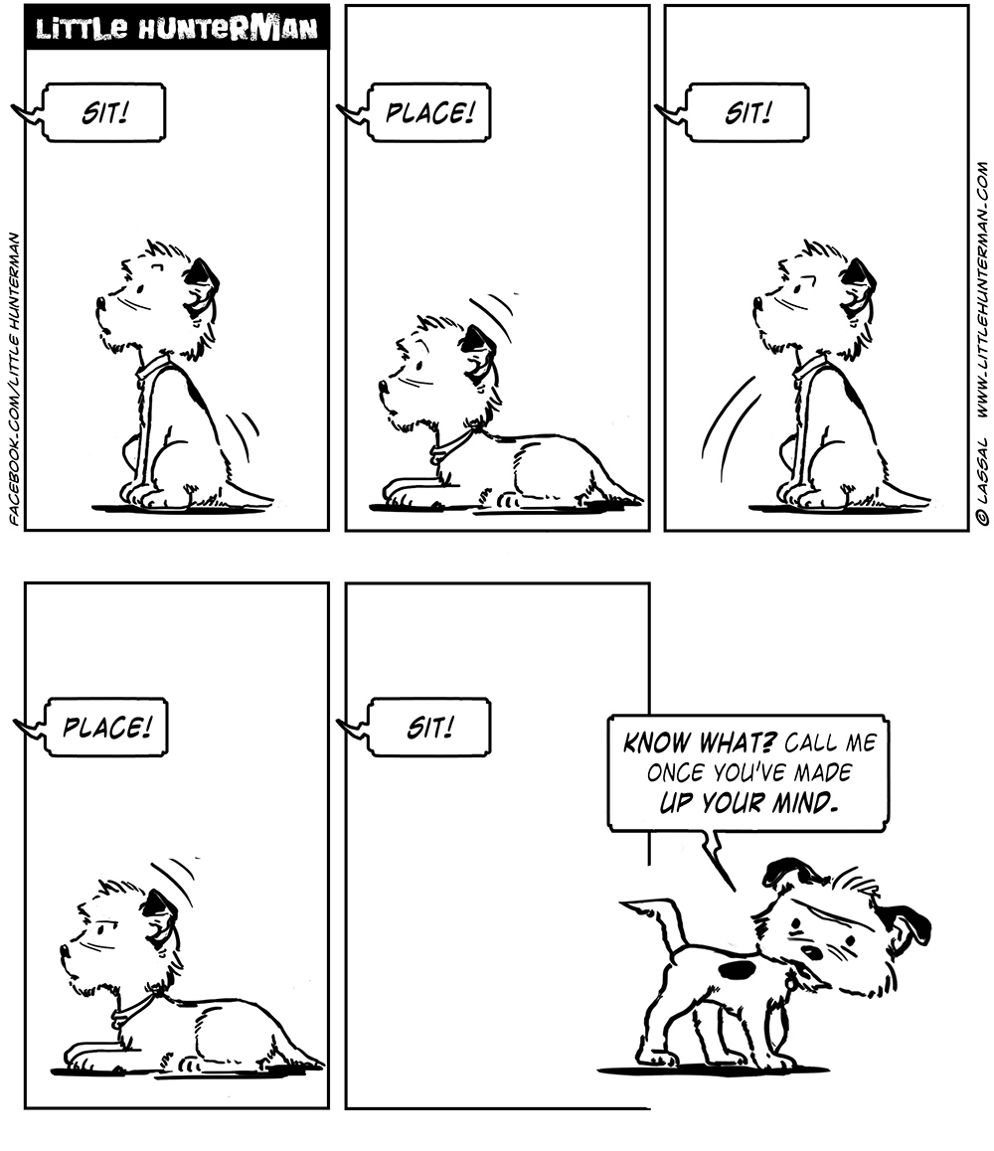
Mixed
Messages
Notes:
What causes Motion Sickness?
You maintain balance with the help of signals sent by many parts of the body — for instance, your eyes and inner ears. Other sensory receptors in your legs, feet and spine let your nervous system know what parts of your body are touching the ground.
Conflicting signals can cause motion sickness. For example, when you’re on an airplane you can’t see turbulence, but your body can feel it. The resulting confusion can cause nausea or even vomiting.

Slide 4

The inner ear in particular is important. As it helps control your sense of balance.
Notes:
In particular the inner ear is important in maintaining control over your balance.

Slide 5
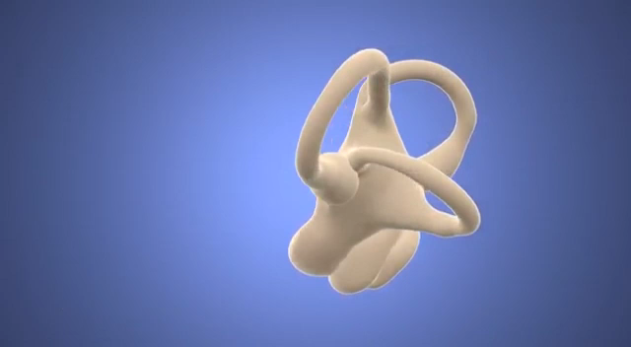
Notes:
The inner ear consists out of the cochlea and the vestibular apparatus.
The vestibular apparatus contains three pairs of semicircular canals and two sacs, called the saccule and the utricle. The latter two are sensitive to gravity. They tell the brain whether you’re standing up or lying down.

Slide 6
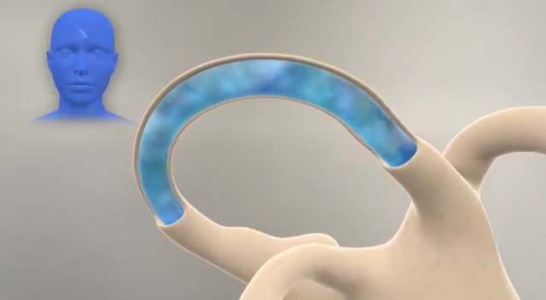
Notes:
The semicircular canals hold a fluid that moves with the turns of your head.
The location of the hair cells in the vestibular apparatus gives information regarding the direction your head is moving through space. These signals are sent in the form of action potentials through the auditory nerve to the brain.
The frequency of the action potentials gives information regarding how quickly your head is accelerating.
This is where conflicts can arise. If your for example spin really fast in your chair, your sensory receptors in your spine and joints tell your brain you are sitting still. However, the fluid in your vestibular apparatus is moving around, telling your brain movement is happening.
A similar thing happens on a boat: when looking at the deck your eyes are telling your brain you are sitting still, but the movement in your vestibular apparatus tells your brain your going up and down.

Slide 7

Some toxins, when ingested, can mess with the vestibular system. And if you’ve got some poison in you, it would be good to throw it up…
Notes:
One hypothesis for ‘why this happens’ comes from evolution. As one of the common symptoms of food poisoning is dizziness, your body reacts to it by throwing up.

Slide 8

MOTION
SICKNESS
Notes:
Sickness in virtual reality exists already for quite a while. I found quite a few articles 20 years old and older describing the effects.
The name however has been evolving throughout the years. There are reports describing ‘simulator sickness’, mostly referring to army simulators.
The one I like the most is ‘cyber sickness’.
Also virtual reality sickness is a thing.
Although there are likely differences between these categories, I think most of these differences relate to the extent of the symptom. All of them relate to the core idea of motion sickness, being a conflict in signals.

Slide 9


WHAT IS
Notes:
Is there a cure?
STOP
Nibble on some crackers / drink some water or a carbonated beverage
Certain scents such as peppermint, ginger, lavender might help
Vitamin B6
The brain can train itself to ignore all sorts of strange things if given months of daily exposure, which is exactly the sort of exposure you get when developing a VR game. This means that developers rapidly become immune to all but the most obvious rendering errors, and as a result they are the worst people at testing their own code.
Don’t break ‘the VR code’
Set the right IPD
Reduce latency, increase FPS
Digital nose. Not the nose itself helps, but having a point of fixation typically helps as a ‘built-in point of reference’. When tested on about 40 subjects, the experiment reduced simulator sickness by 13.5 percent. Surprisingly, when the group was asked whether the nose was distracting, they were perplexed. "Several of them didn't believe us when we told them about the nose," says Whittinghill.

Slide 10

GIMME MORE
References:
“How the Inner Ear Balance System Works” - https://youtu.be/YMIMvBa8XGs
“Hearing & Balance: Crash Course” - https://youtu.be/Ie2j7GpC4JU
https://www.healthline.com/health/motion-sickness
https://www.webmd.com/cold-and-flu/ear-infection/motion-sickness#1
https://www.theatlantic.com/health/archive/2015/02/the-mysterious-science-of-motion-sickness/385469/
https://uploadvr.com/7-ways-overcome-vr-motion-sickness/
https://journals.sagepub.com/doi/pdf/10.1177/107118139704100292
https://dl.acm.org/citation.cfm?id=333344
https://www.frontiersin.org/articles/10.3389/fpsyg.2018.02132/full
https://www.engadget.com/2015/03/24/virtual-nose-could-reduce-simulator-sickness/
https://developer.oculus.com/blog/vr-sickness-the-rift-and-how-game-developers-can-help/
Notes:
If you want more…

